Slide 1
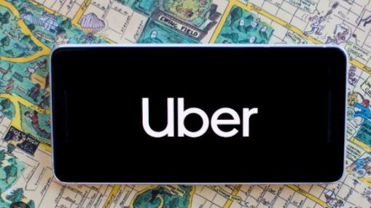

INTRODUCTION 1.1 OVERVIEW
Uber was born on a snowy night in paris in 2008.
Uber is a transporation company with an app that allows passengers
To hail a ride and drivers to charge fares and get paid.
More specifically , Uber is a ridesharing company that hires independent
Contractors as drivers.

Slide 2
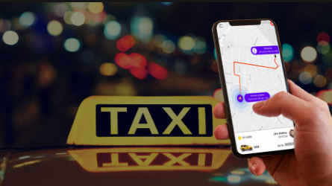
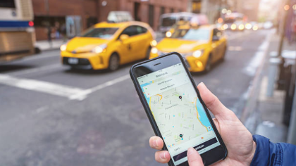
1.2 PURPOSE
Uber is a ride-hailing company that offers that offers the uber app ,which you can use to submit a trip request that is automatically sent to an uber drivers near you ,alerting the driver to your location . The accepting uber driver will then come and pick you up and driver you to requested destination.

Slide 3
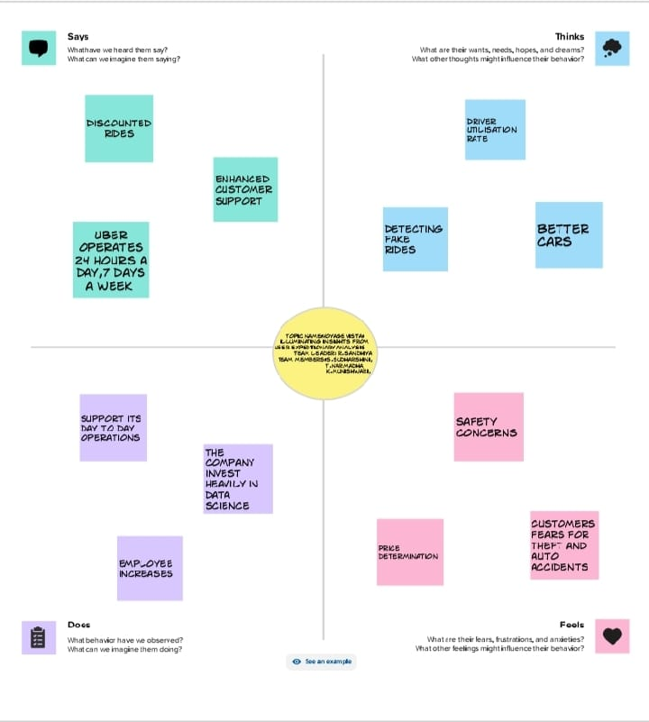
2.Problem Definition and Design Thinking
2.1 Empathy map

Slide 4
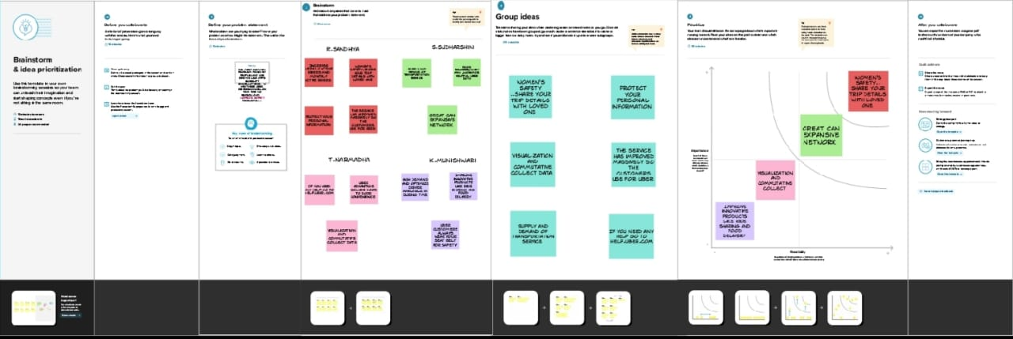
2.2 Ideation and Brainstorming Map

Slide 5
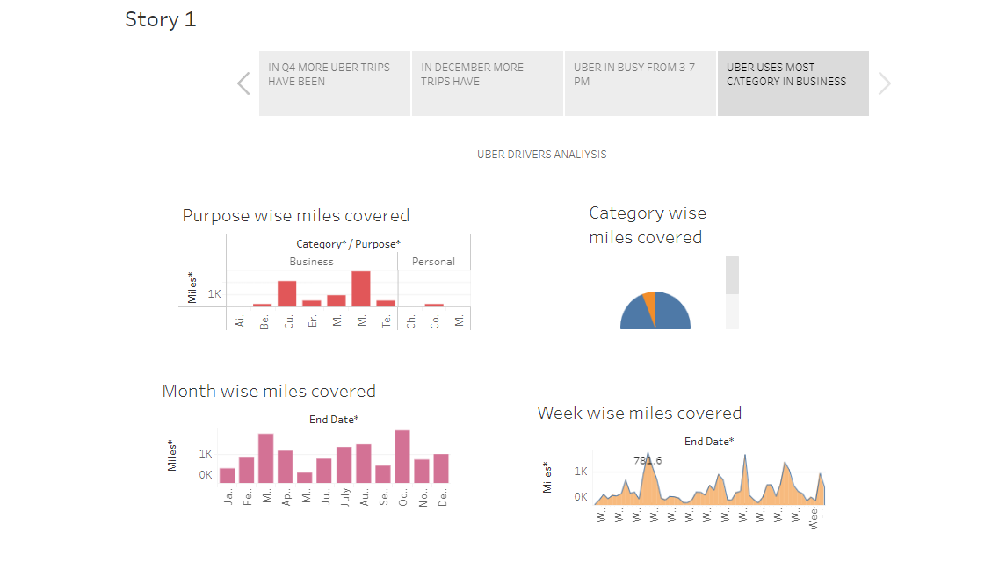
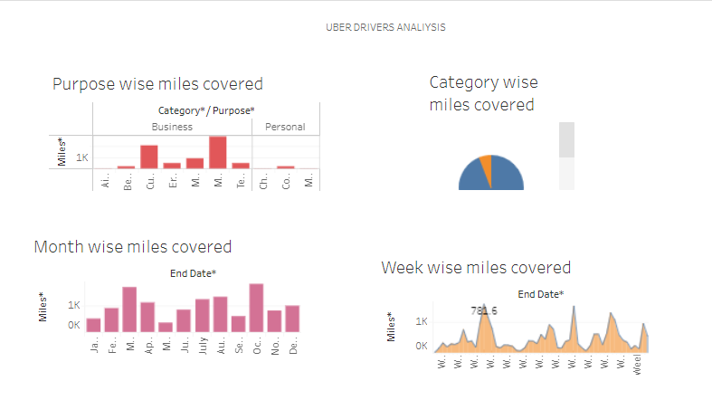
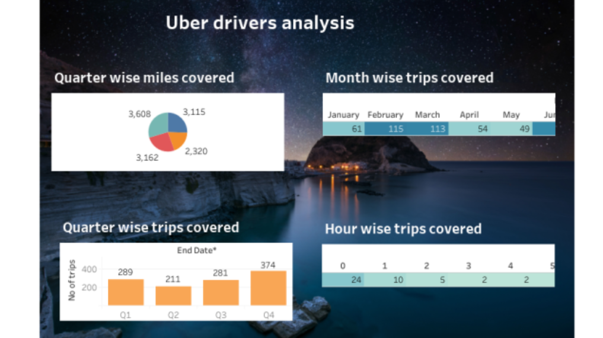
3.RESULT
DASHBOARD
STORY

Slide 6
ADVANTAGES
Uber has become a prime examples of the gig economy at work.
Uber’s advantages include:
*door-to-door convenience
*safety
*reliable quality
DISADVANTAGES
Surge pricing and the negative effects of replacing steady jobs with gig
Work. The company has disrupted taxicab business and allegedly caused
Increase in traffic congestion.

Slide 7
APPLICATIONS
The uber app is a great way to make your travel plans stress-free
Request a trip on demand or schedule one ahead of time
The united states remains at the summit of the most popular countries
Uber’s app ,you resource on the road
Marketing and user acquisition
Research and pick your ride- sharing app business model
Further development and growth

Slide 8
CONCLUSION
I hope this article is useful for every on demand startup .It also helps in
Fulfilling each and every need of the customer with whatever they need will
Be available at a single tap.Also it provides a great opportunity for
Startups to go with such an innovative idea.
By seeing the above predictions and reason behind the success of the on
Demand business ,we came to conclude that it should be the way of the
future

Slide 9
FUTURE SCOPE
Providing a unique experience
Advancements in technologies
Gaining competitive advantage
Easy availability and use
More choices for business space
Flexibility and affordability

